Slide 1
Equifax
2017 Hackathon
Explore Mars
Team: Cranberry Pi
Members:
Kaushik Vedalaveni, Grad, CSSE
Yue Cui, Grad, CSSE
Tian Liu, Grad, CSSE

Slide 2

Web application
Frame: Bootstrap
Language: HTML
JavaScript
JQuery

Slide 3
A
Index
Index page shows some information about mars.
Architecture
Design
B
Select Rover
We provide 3 rover options to users as well as mission overview of the rovers, which users can make choice with.
C
Query time limitation
Unavailable dates
efficiency
Select Camera
The name of cameras are listed with pictures. Unavailable cameras are disabled.

Slide 4
D
Select Date
One date each time. Users are allow to select either a sol or earth date. Unavailable dates are restricted.
Architecture
Design
E
Show results
Photo waterfall. Click to overview large pictures.
Query time limitation
Unavailable dates
efficiency

Slide 5

Live Demo
Auto slide
Photo waterfall

Slide 6
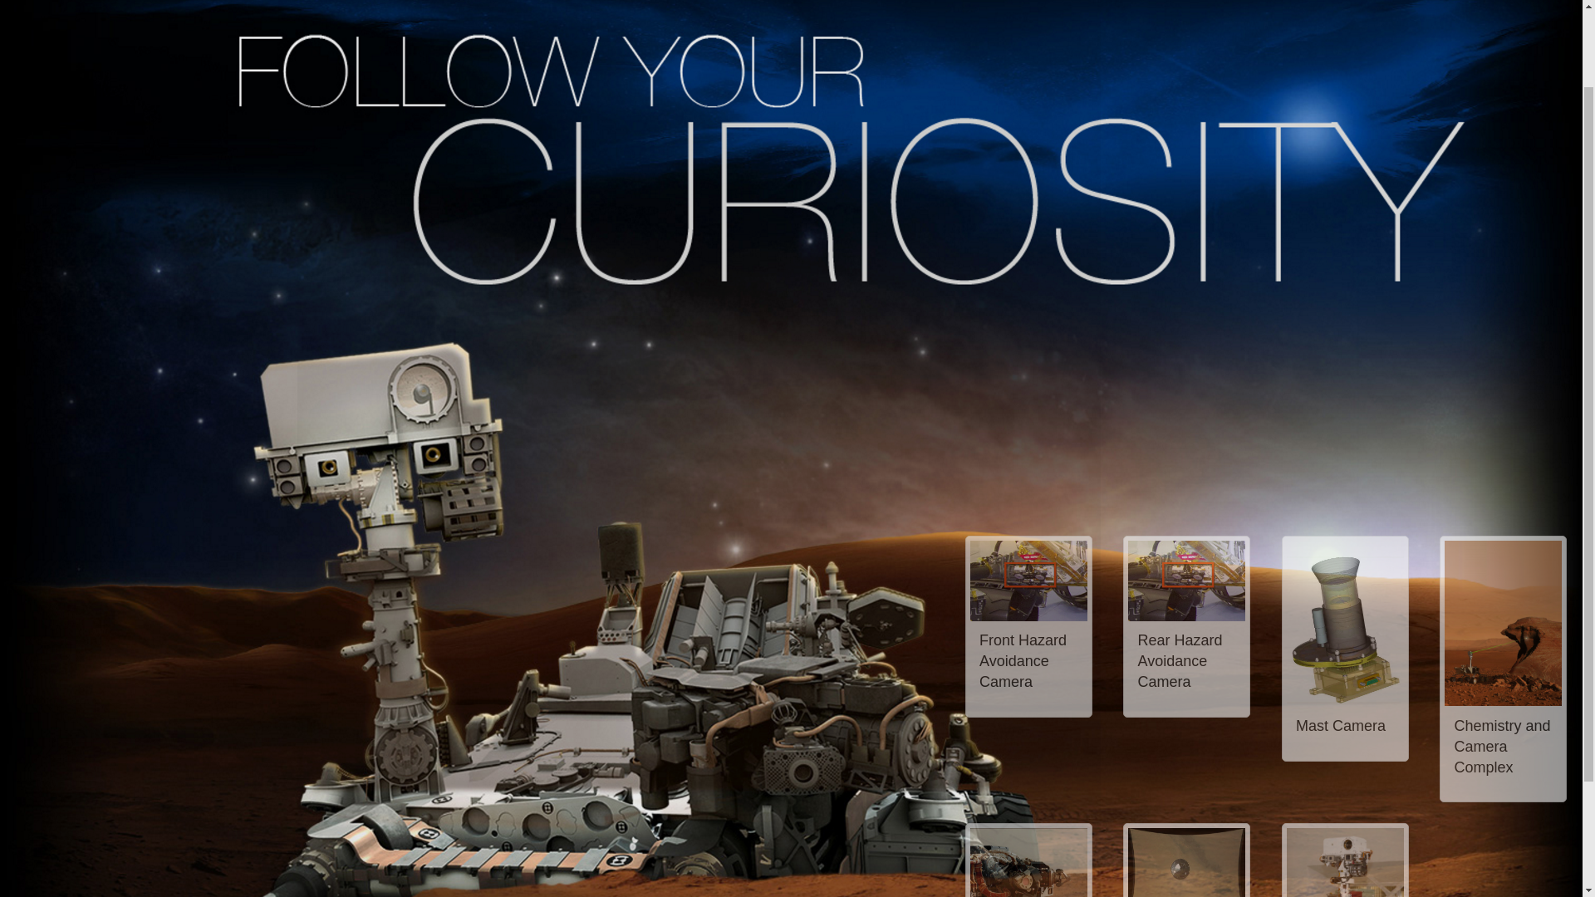
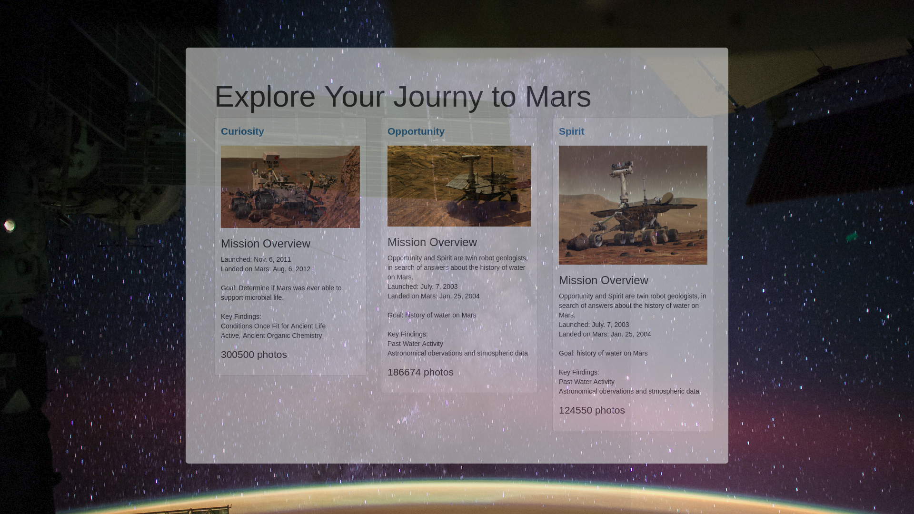
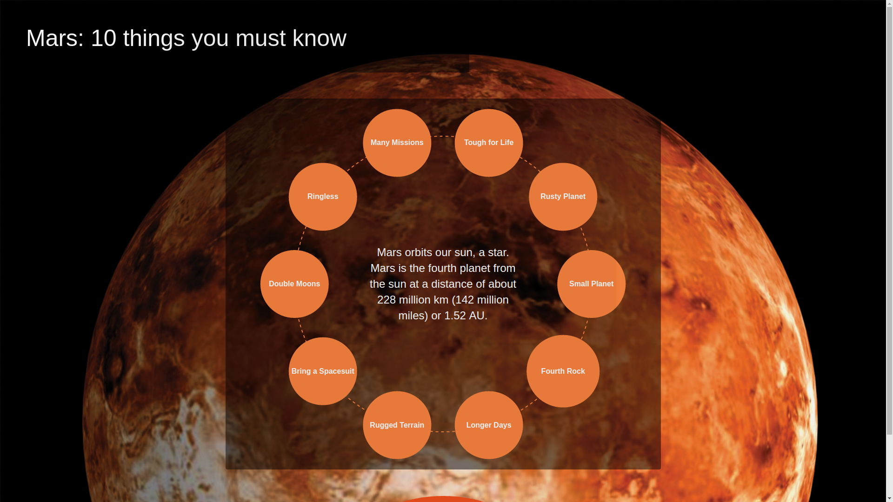
Questions
&
Answers
Notes:
<number>

